Slide 1
Data Extraction for the Quantified Self
Svetlana Pospelova
Viacheslav Inozemtsev

Slide 2
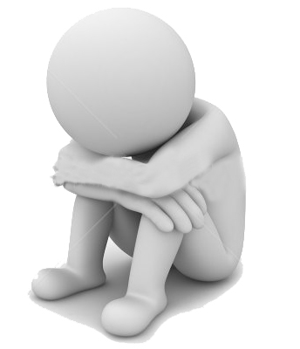
Introduction
Measurement of human’s indoor movements is useful for analyzing treatment progress of depressed people. It shows how actively person behaves, and gives objective view of his or her psychological condition.

Slide 3
Overview
Approach
Implementation
Experiments

Slide 4
1. Approach
Analysis of surrounding Wi-Fi networks to retrieve person’s indoor position:
signal strength of each network carries partial information about where smartphone is located at the moment;
combining this information we infer person’s position.

Slide 5
1. Approach
Machine learning techniques:
k nearest neighbors
Neural network
Cross validation

Slide 6
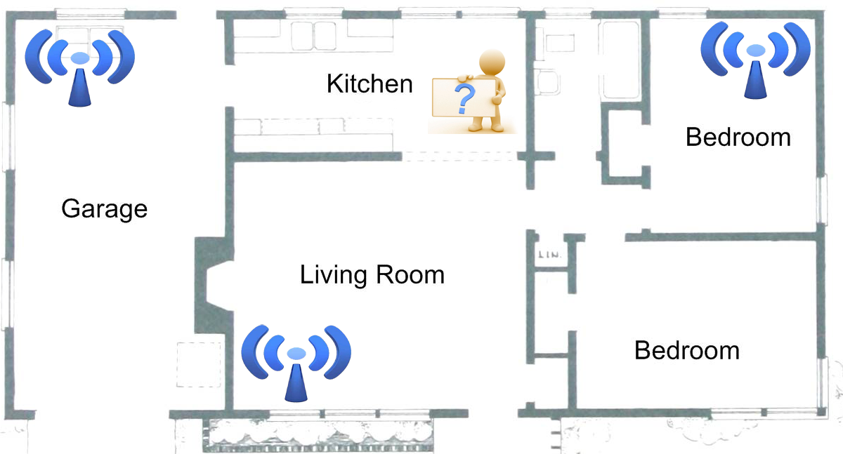
1. Approach

Slide 7
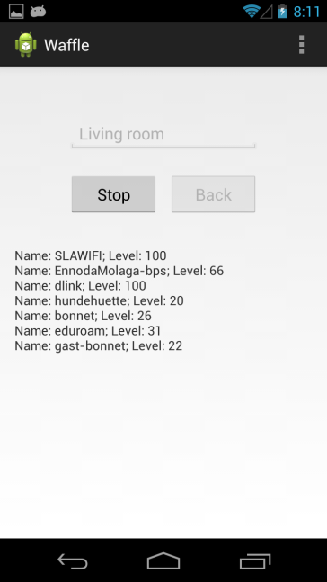
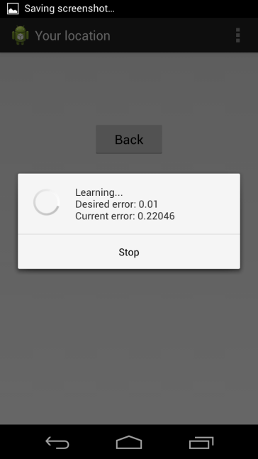
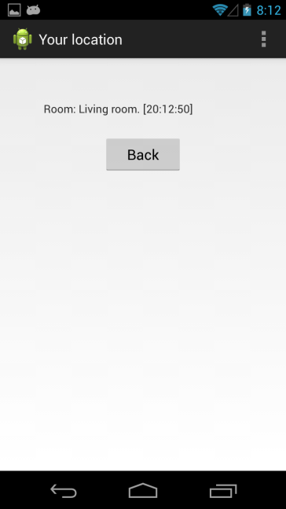

2. Implementation

Slide 8
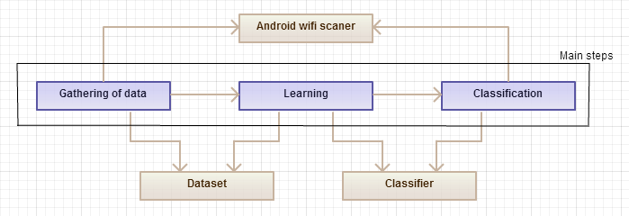
2. Implementation

Slide 9
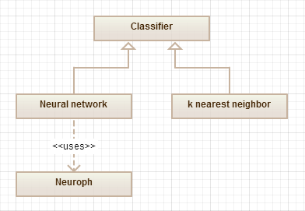
2. Implementation

Slide 10
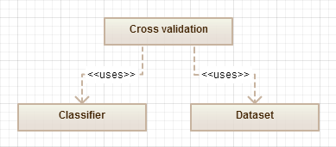
2. Implementation

Slide 11
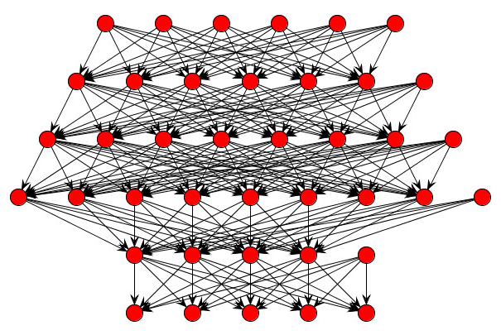
2. Implementation
Neuroph is lightweight Java neural network framework to develop common neural network architectures.

Slide 12
3. Experiments
Cross-validation technique to analyze accuracy of obtained classifier.
Desktop application for executing cross-validation on different datasets.

Slide 13
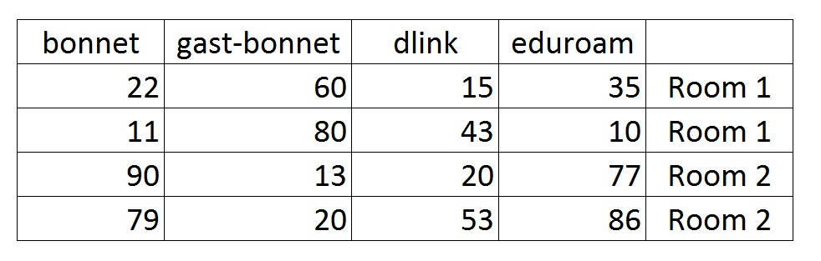
3. Experiments
attributes
instances
labels

Slide 14
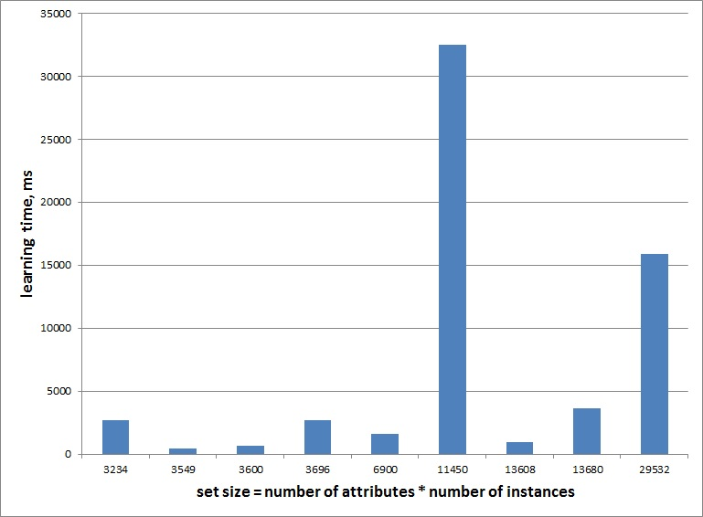
3. Experiments

Slide 15
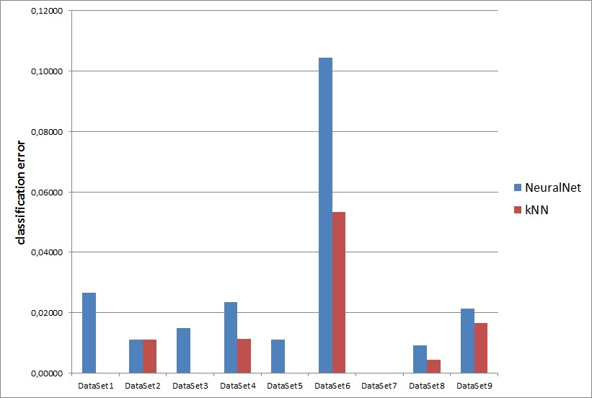
3. Experiments

Slide 16
Conclusion
Stable working Android application
Reliable classification results
Reasonable working time
Can be used in the future for psychological research

Slide 17
Thank you for attention

